Slide 1

2021-2022
CSE 305 – SOFTWARE ENGINEERING COURSE PROJECT
MIDTERM PRESENTATION
ELIHAN TECH
Elize Hamitoğlu 181805052
&
Nagihan Baz 171805024

Slide 2
Look At The Sky

Slide 3
Content
• What is the purpose of the project?
• Who are the users of the project and what are their needs?
• What are the main functional requirements of the project?
• Use-Case Diagram
• What are the main non-functional requirements of the
project?
• What are the highlights of the product backlog and sprint
planning strategies?
• What did we learn about interacting with the customer, teamwork and other non-technical aspects of the project?

Slide 4
What is the purpose of the project?
Our project is a website. Its name is Look at the sky. Its purpose is for astrologers who are interested in fortune-telling and people who are interested in astrology.

Slide 5
Who are the users of the project and what are their needs?
Users who log in will be able to observe the characteristics of their sign and the effect of the sky on people, and they will be able to access weekly horoscope comments, relationship compatibility between signs, and financial and health problems that may occur.

Slide 6
What are the main functional requirements of the project?
•The Look At The Sky allows Admin to update announcements.
•The Look At The Sky allows Admin to delete users.
•The Look At The Sky allows user to play a game.
•The Look At The Sky allows user to test his/her sixth-senses.
•The Look At The Sky allows user to comment and report.
•The Look At The Sky allows to everyone can find their zodiac sign.
•The Look At The Sky allows to everyone the registration and during that it checks emails if its already exist.

Slide 7
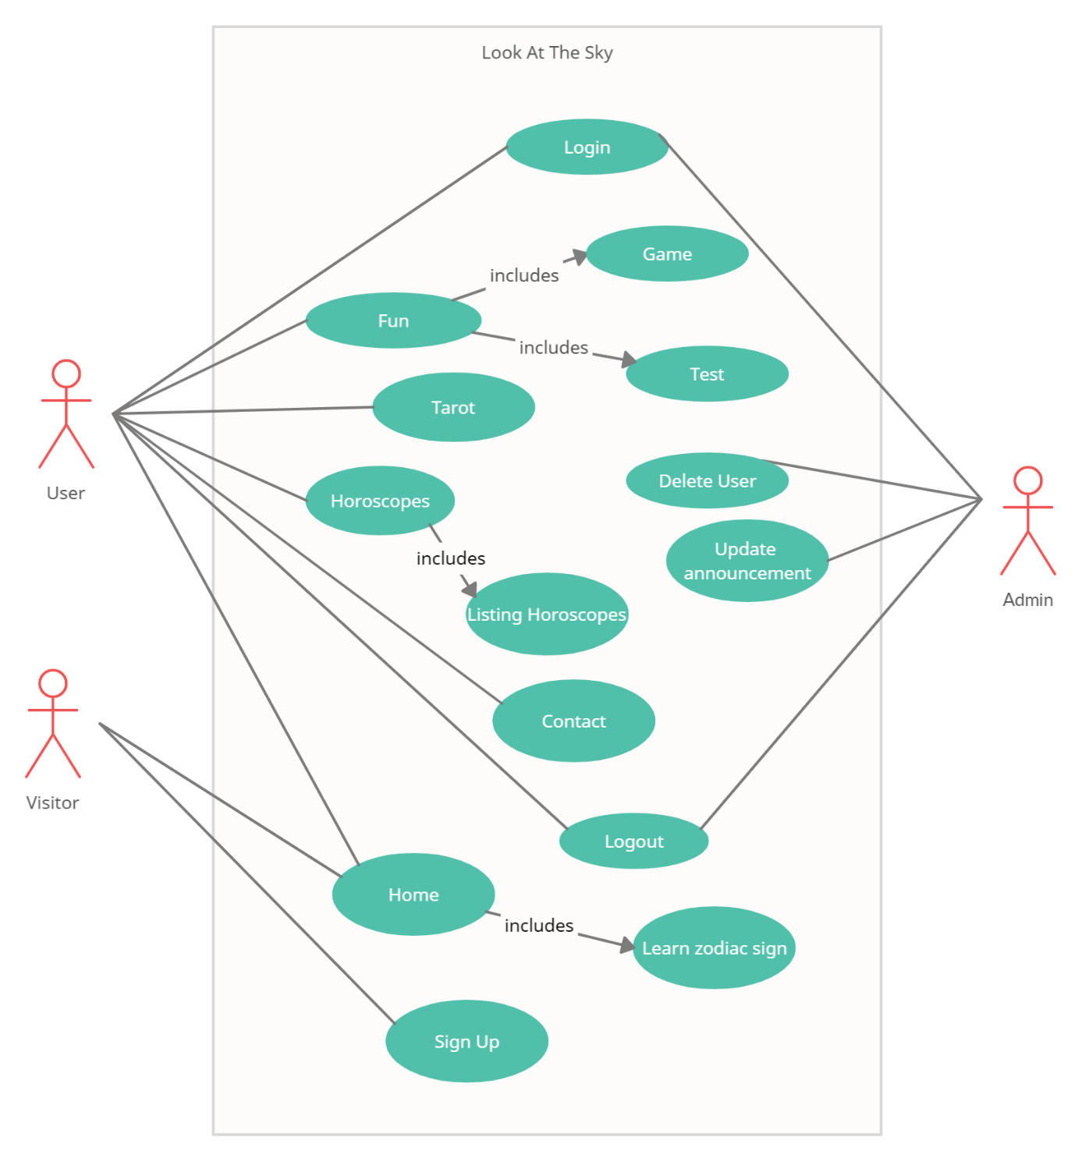
Use-Case Diagram

Slide 8
What are the main non-functional requirements of the project?
Product Requirements:
Performance Requirements:
▪Available 7/24.
▪Run fast enough on any operating system for personal computer.
Security Requirements:
▪If someone does not enter long time, that user is going be removed from the system.
Usability Requirements:
▪User-friendly interface.
▪The platform can be used by any people.
Organizational Requirements:
Operational Requirements:
▪Look At The Sky works well in any Internet browser.

Slide 9
What are the highlights of the product backlog and sprint planning strategies?
First Sprint
Log In
Log Out

Slide 10
What are the highlights of the product backlog and sprint planning strategies?
Second Sprint
Horoscope
Tarot

Slide 11
What are the highlights of the product backlog and sprint planning strategies?
Third Sprint
Announcement
Test

Slide 12
What are the highlights of the product backlog and sprint planning strategies?
Fourth Sprint
Game
Delete User
Learn Zodiac Sign

Slide 13
What did we learn about interacting with the customer,teamwork and other non-technical aspects of the project?
Agile project management
We discovered our strengths.
The importance of different ideas.
Feedback from customers improved the project.

Slide 14
Thank you for listening.

